Slide 1

Studying Socioeconomic Factors of COVID-19 & Calculating Metric to Determine its Lag Period
Emily wang & Dileka Gunawardana

Slide 2
What is Lag?
Period between when the patient
Contracts COVID-19 & becomes a transmitter of the disease and
Receives positive result
Important to quantify in order to
Better understand the true number of cases at a given moment
Determine if there are associations between lag and various socioeconomic factors
Potentially reduce lag period

Slide 3

Timeline of a COVID-19 Death
k
Onset of Patient’s Symptoms
Patient Officially Positive
Patient is
Tested
Patient
Death
lag
a
Cases Curve
Deaths Curve

Slide 4
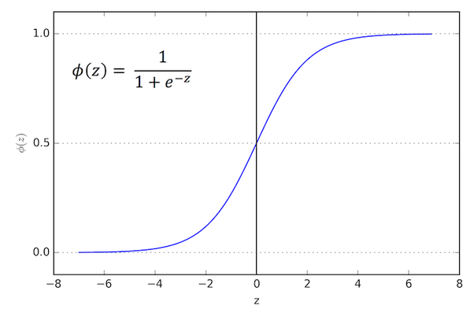
Lag Metric Calculation
Logistic regressions have been shown to best model both the COVID-19 deaths and cases¹
Average time between onset of symptoms and death is relatively constant within a certain population²
Therefore, assume period between onset of symptoms and death is a constant k
Deaths curve not affected by lag; however, the cases curve is affected by lag
Therefore, assume the difference between the two curves is some value a
Calculated by finding the difference in the number of days between when each respective curve reached 50% of its max
Lag = k – a

Slide 5
Country Lag Metric Comparisons
Country | Lag Metric
Italy | 66.784
Spain | 70.201
France | 73.278
UK | 74.982
US | 75.121
Metric is exaggerated estimate for a, so the lower the number, the longer the lag period
Important to consider:
Italy and the UK have different healthcare systems, so average period between the onset of symptoms and death may not be constant
Numerous factors affect lag at country-level
Perhaps more useful at county level as physical environments and state/ federal funding constant

Slide 6
References
Jia Lin; Li, Kewen; Jiang, Yu; Guo, Xin; Zhao, Ting; “Prediction and Analysis of Coronavirus Disease 2019”. China University of Geosciences & Stanford University. https://arxiv.org/ftp/arxiv/papers/2003/2003.05447.pdf
Verity, Robert; et al. “Estimates of the Severity of Coronavirus Disease 2019: a Model-Based Analysis”. The Lancet. Imperial College London. <https://www.thelancet.com/action/showPdf?pii=S1473-3099%2820%2930243-7>

